Slide 1
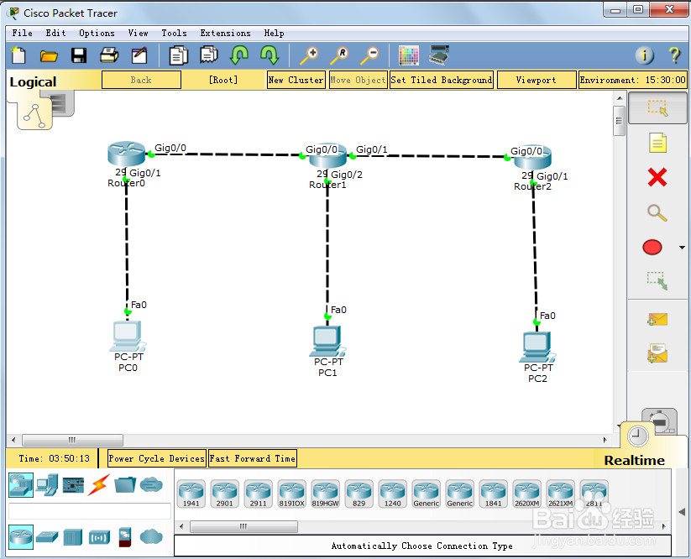
2911

Slide 2
ip规划：
pc0:192.168.10.2/24
pc1:192.168.20.2/24
pc2:192.168.30.2/24
router0 gig0/0:10.1.1.1/24
router0 gig0/1:192.168.10.1/24
router1 gig0/0:10.1.1.2/24
router1 gig0/1:10.1.2.1/24
router1 gig0/1:192.168.20.1/24
router2 gig0/0:10.1.2.2/24
router2 gig0/1:192.168.30.1/24

Slide 3
配置个路由器接口ip：
router0:
configure terminal
interface gigabitEthernet 0/1
ip address 192.168.10.1 255.255.255.0
no shutdown
exit
interface gigabitEthernet 0/0
ip address 10.1.1.1 255.255.255.0
no shutdown
exit
do show ip interface brief

Slide 4
router1:
configure terminal
interface gigabitEthernet 0/1
ip address 10.1.2.1 255.255.255.0
no shutdown
exit
interface gigabitEthernet 0/0
ip address 10.1.1.2 255.255.255.0
no shutdown
exit
interface gigabitEthernet 0/2
ip address 192.168.20.1 255.255.255.0
no shutdown
exit
do show ip interface brief
router2:
configure terminal
interface gigabitEthernet 0/0
ip address 10.1.2.2 255.255.255.0
no shutdown
Exit
int gig0/1
ip addr 192.168.30.1 255.255.255.0
Exit
do show ip interface brief

Slide 5
配置路由器上的rip协议：
router0:
config t
router rip
version 2
network 192.168.10.0
network 10.1.1.0
do show ip protocols
router1:
config t
router rip
version 2
network 10.1.2.0
network 10.1.1.0
network 192.168.20.0
do show ip protocols
router2:
config t
router rip
version 2
network 10.1.2.0
network 192.168.30.0
do show ip protocols
PC0验证是否联通：
ping 192.168.20.2
ping 192.168.30.2

Slide 6
特权模式Router# show ip protocols
全局配置模式 Router(config)#do show ip protocols
等价
一般思科的设备如果当前不是在#和>模式下，
想查看或者测试，使用show的时候，要在前面加个DO

